Slide 1
Taxicab intersections
By Evan Mata, Nanut Chaichanawanich, Vu Phan

Slide 2
Project Description
Why New year’s day?
Hypothesis
Our goal was to identify locations of high congestion in New York City. This was done by using taxi-cab rides occuring during the same time chunk, and with a few approximations, seeing where different rides overlapped. The density of overlapping rides was used as a proxy for congestion.
Since we can only choose to do analysis for one day (due to limitations we will mention later). We chose new year’s day since we thought it would give an interesting analysis since people go out to count down (drinking? flying in to celebrate with friends? Etc.) so there will be large numbers of trips made.
Spatially, we expect places of celebration and festivity, such as the downtown area, to have a higher volume of traffic (more intersection points) than less central areas. Temporally, we expect traffic to be high right after midnight, go down in the morning hours (people sleeping in after staying up late for new year celebrations) and pick up again later in the day.

Slide 3
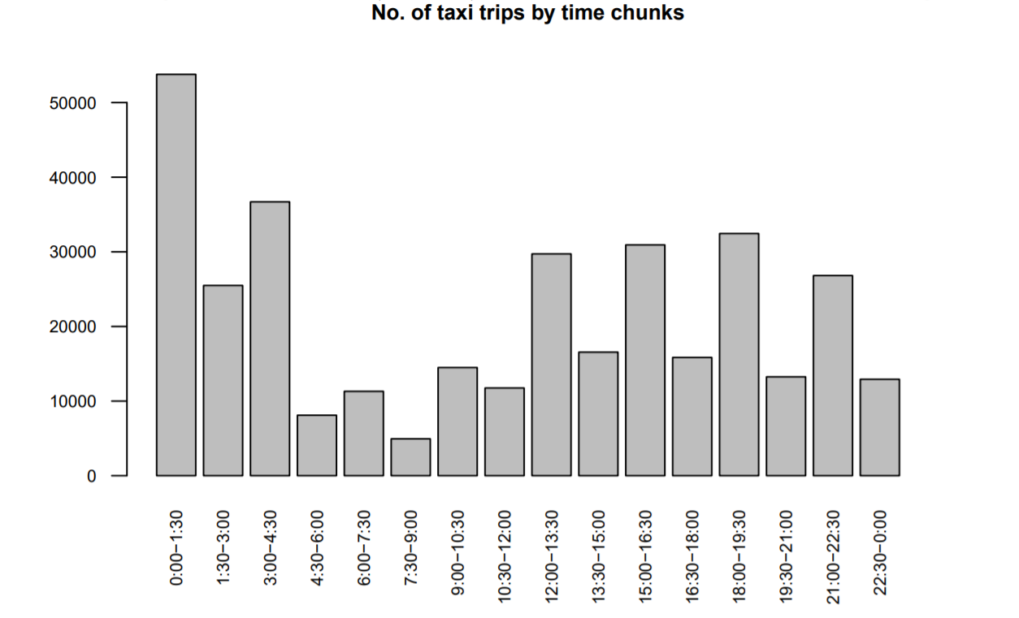
Dataset
All yellow cab taxi rides (NYC) in Jan 2016: 1.7GB csv
1 day worth of data: 41.5MB
Split it into 16 time chunks of 1.5 hours a chunk
Smallest chunk: 582 kB (5k rides)
Largest chunk: 6.3 MB (54k rides)
Why this chunk size?
With 16 chunks, a week’s data had a maximum chunk size 34.9 MB (290k rides) and a minimum chunk size of 3.3MB (27k rides). Our 54k rides file took 2.33 hours to process, this means our 290k file would have been approximately 6ˆ2 = 36 times longer to process, or about 84 hours. If we did chunks 2 hours each. So assuming our rides count scaled by exactly by this 16/12 factor, it would have taken approximately 150 hours

Slide 4
Algorithm
Divide data into 1.5 hour chunk.
Represent each taxi trip as a line segment.
Look at all pairwise comparisons and calculate intersections.
Round lat-lon intersection to 3 decimal places.
Use mapreduce to collapse identical lat-lon intersection (rounded) together.
Use information about intersections to produce heat maps.

Slide 5
Big Data
If we have m chunks, each with n lines, complexity is mn^2
Decreasing chunk size too much does not work as having chunk size smaller than the length of a taxi ride would defeat the purpose.
Largest chunk, for a single day’s data, took ~2.33 hours to run with 20 cores
This would take ~46 hours on a single core machine
Doing all 16 chunks would therefore take on the order of a week
Time savings are compounded in other ways too, such as debugging

Slide 6
Challenges
How to chunk
How large should chunks be? Should we use mapreduce (pros and cons?) One file and loop over using if statements or chunk them into their own files?
Getting dataproc to work on Google compute engine VM
What modifications need to be made?
Uploading files to dataproc (Our biggest problem)
Developing using local VM and heavy reliance on CSV library file access to read and write. Not scalable to many reducers transferable to dataproc
Using --file. Having to put it in init, storing it as a list, will we have enough memory?
How to run mapreduce faster?
What is the most efficient way to run this? We did not anticipate having to use more 24 cores before we got dataproc running so did not request quota. So 5 instances of 4 core high-powered cpu.
Heat map
Choropleth vs Heatmap. How to deal with that many intersection points? Solution: Rounding. Libraries that support lat long and weight?
Original project
Shifting time frame, not big data

Slide 7
Seeing the results
Demo of the live interactive map in Jupyter Notebook

Slide 8
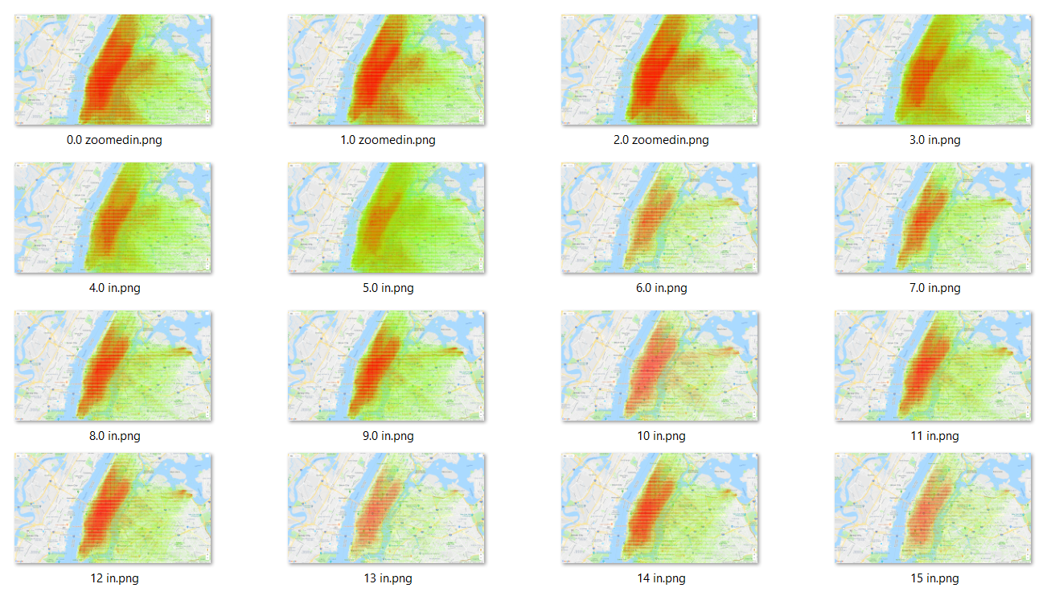
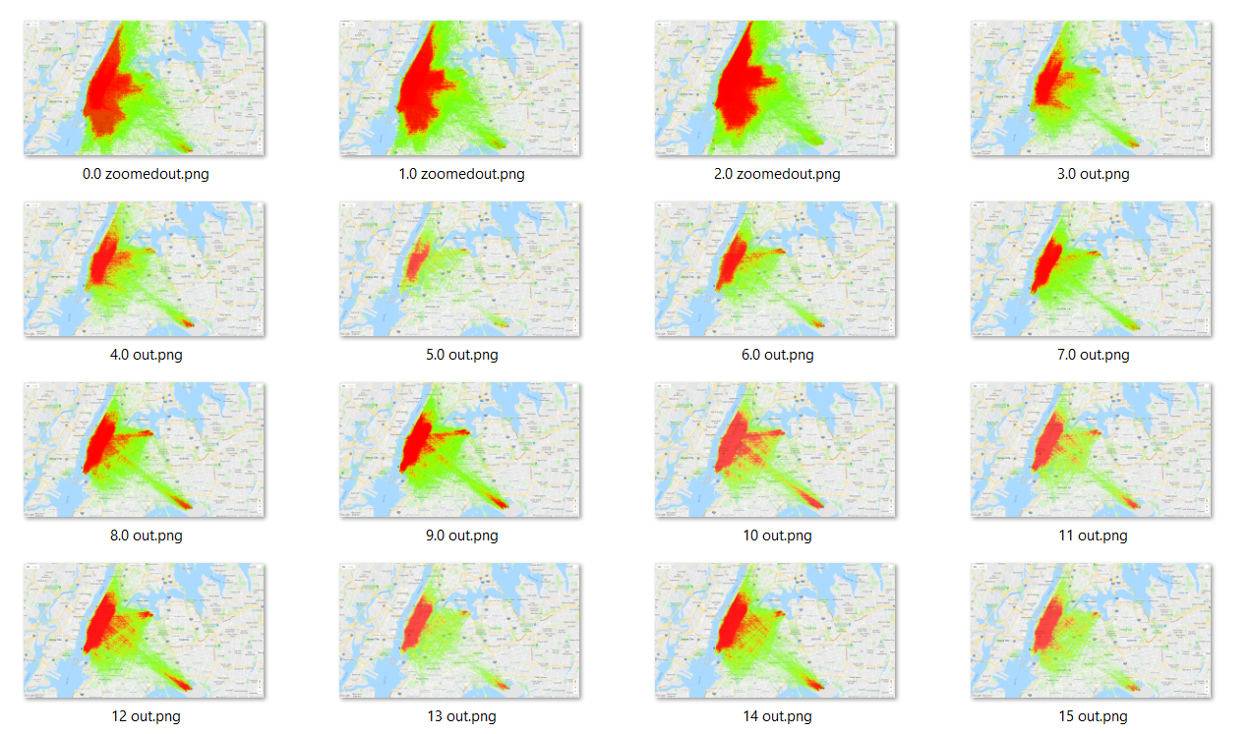
Seeing the change through time
We can see central park
We can see that roads leading to the two airports have very high traffic
Right after midnight, very heavy traffic till 4:30am and it then dies down (see size of traffic jam).

Slide 9
Seeing the change through time
(gifs omitted due to git maximum file size restriction – please refer to the Screenshot folders)

